Slide 1
Fundamentals of Information Technology UNIT - III

Slide 2
Learning Objectives
In this Unit we will discuss :
Introduction to Operating system
Different types of operating systems and its working
File Structure and Storage
Introduction to process management:
Threads
Scheduling and Synchronization
Introduction to Database Management System and its types

Slide 3
Operating System
It keeps track of the status of each resource and decides who will have a control over computer resources.
It acts as an interface between users and the hardware of a computer system.
The most fundamental system program is the operating system - it controls all the computer's resources and provides the base upon which the application programs can be written.
It is a program that acts as an intermediary between a user of a computer and the computer hardware; it controls and coordinates the use of this hardware among its users.

Slide 4
Operating System
A mechanism for scheduling jobs or processes. Scheduling can be as simple as running the next process, or it can use relatively complex rules to pick a running process.
A method for simultaneous CPU execution and IO handling. Processing is going on even as IO is occurring in preparation for future CPU work.
Examples of OS: Windows, Linux, Unix, MacOs etc

Slide 5
Operating System
The CPU is wasted if a job waits for I/O. This leads to:
Multiprogramming ( dynamic switching ). While one job waits for a resource, the CPU can find another job to run. It means that several jobs are ready to run and only need the CPU in order to continue.
All of this leads to:
memory management
resource scheduling
deadlock protection

Slide 6
Operating System
Application Programs
System Programs
Software (Operating System)
HARDWARE

Slide 7
Operating System
The structure of OS consists of 4 layers:
Hardware
Hardware consists of CPU, Main memory, I/O Devices, etc,
Software (Operating System)
Software includes process management routines, memory management routines, I/O control routines, file management routines.

Slide 8
Operating System
System programs
This layer consists of compilers, Assemblers, linker etc.
Application programs
This is dependent on users need. Ex. Railway reservation system, Bank database management etc.,

Slide 9
Batch Processing
In Batch processing same type of jobs (BATCH- a set of jobs with similar needs) together execute at a time.
The OS was simple, its major task was to transfer control from one job to the next.
The job was submitted to the computer operator in form of a batch. At some later time the batch of programs is executed and the output is produced.
The OS was always resident in memory. (Ref. Fig. next slide)
Common Input devices were card readers and tape drives.

Slide 10
Batch Processing
Common output devices were line printers, tape drives, and card punches.
Users did not interact directly with the computer systems, but he prepared a job (comprising of the program, the data, & some control information).
OS
User program area

Slide 11
Multiprogramming
Multiprogramming is a technique to execute number of programs simultaneously by a single processor.
In Multiprogramming, number of processes reside in main memory at a time.
The OS picks and begins to executes one of the jobs in the main memory.
If any I/O wait happened in a process, then CPU switches from that job to another job.
Hence CPU in not idle at any time.

Slide 12
Multiprogramming
OS
Job 1
Job 2
Job 3
Job 4
Job 5
Figure depicts the layout of multiprogramming system.
The main memory consists of 5 jobs at a time, the CPU executes one by one.
Advantages:
Efficient memory utilization
Throughput increases
CPU is never idle, so performance increases.

Slide 13
Operating System
The main functions of operating systems are:
Process management
Memory management
Input/Output management
Error detection
Resource allocation
File management
Protection

Slide 14
Operating System
Operating System can also be classified as,-
Single User Systems
Multi User Systems

Slide 15
Single User
Provides a platform for only one user at a time.
They are popularly associated with Desk Top operating system which run on standalone systems where no user accounts are required.
Example: DOS

Slide 16
Multi User
Provides regulated access for a number of users by maintaining a database of known users.
Refers to computer systems that support two or more simultaneous users.
Another term for multi-user is time sharing.
Ex: All mainframes are multi-user systems.
Example: Unix

Slide 17
Multi tasking OS
The ability to hold several programs in RAM at one time but the user switches between them.
The CPU is multiplexed among several jobs that are kept in memory and on disk (the CPU is allocated to a job only if the job is in memory).
A job is swapped in and out of memory to the disk.
On-line communication between the user and the system is provided; when the operating system finishes the execution of one command, it seeks the next “control statement” from the user’s keyboard.

Slide 18
Multitasking OS
§ Simultaneous interactive use of a computer system by many users in such a way that each one feels that he/she is the sole user of the system
§ User terminals connected to the same computer simultaneously
§ Uses multiprogramming with a special CPU scheduling algorithm
§ Short period during which a user process gets to use CPU is known as time slice, time slot, or quantum
§ CPU is taken away from a running process when the allotted time slice expires

Slide 19
Multiprocessor OS
Multiprocessor systems - with more than on CPU in close communication.
Tightly coupled system – processors share memory and a clock; communication usually takes place through the shared memory.
Advantages of parallel system:
Increased throughput
Economical
Increased reliability
Graceful degradation
Fault tolerant systems

Slide 20
Multiprocessor OS
Symmetric multiprocessing (SMP)
Each processor runs an identical copy of the operating system.
Many processes can run at once without performance deterioration.
Most modern operating systems support SMP
Asymmetric multiprocessing
Each processor is assigned a specific task by master
Master schedules and allocated work to slave processors.
More common in extremely large systems

Slide 21
Multiprocessing

Slide 22
Real Time OS
Often used as a control device in a dedicated application such as controlling scientific experiments, medical imaging systems, industrial control systems, and some display systems.
• Well-defined fixed-time constraints.
• Real-Time systems may be either hard or soft
real-time.

Slide 23
OS Types
Hard real-time:
Secondary storage limited or absent, data stored in short term memory, or read-only memory (ROM)
Conflicts with time-sharing systems, not supported by general-purpose operating systems.
Soft real-time
utility in industrial control of robotics
Useful in applications (multimedia, virtual reality) requiring advanced operating-system features.

Slide 24
Distributed OS
Distributed system - Processing is carried out independently in more than one location, but with shared and controlled access to some common facilities.
Requires network infrastructure.
Distribute the computation among several physical processors.
• Loosely coupled system – each processor has its own local memory; processors communicate with one another through various communications lines, such as high-speed buses or telephone lines.
• Advantages of distributed systems.
Resources Sharing
Computation speed up – load sharing
Reliability
Communications

Slide 25
Operating System
Characteristics of an Operating System
Multi-User: Allows two or more users to run programs at the same time. Some operating systems permit hundreds or even thousands of concurrent users.
Multi Processing: Supports running a program on more than one CPU.
Multi Tasking: Allows more than one program to run concurrently.
Multithreading: Allows different parts of a single program to run concurrently.
Real time: Responds to input instantly. General-purpose operating systems, such as DOS and UNIX, are not real-time.

Slide 26
DOS Commands
The command prompts:
cd < directory name>
cd is the basic DOS command, it allows you to change directory.
dir [ name of directory]
dir allows you to list all contents of the specified directory.
copy <source> <destination>
Allows you to copy a file from a <source>folder to a <destination folder>.
del<file>
delete specific file.

Slide 27
DOS Commands
move <source> <destination>
Allows you to move a file from a <source>folder to a <destination folder>.
ren <source> <destination>
Rename the specified file.
edit <filename>
Opens the default DOS editor to allow modification of specified file.
cls
Clear DOS screen.
exit
Leave the DOS terminal.

Slide 28
Process
A Process – a program in execution; process execution must progress in sequential fashion.
A process includes: program counter, stack, data section.
Process Management concerns with the control of programs within the system.
The term process refers to a program that is loaded into computer memory and is being executed i.e. is utilizing CPU time.
Operating system can allocate system resources, so the process will execute in either user mode or system mode (system mode has direct access to resources).

Slide 29
Process
A program is passive unit; a process is active unit of work.
Attributes held by a process includes:
hardware state,
memory,
CPU,
progress (executing)
WHY HAVE PROCESSES?
Resource sharing ( logical (files) and physical(hardware) ).
Computation speedup - taking advantage of multiprogramming – i.e. example of a customer/server database system.
Modularity.

Slide 30
Process
New The process has just arrived.
Running Instructions being executed. This running process holds the CPU.
Waiting For an event (hardware, human, or another process.)
Ready The process has all needed resources - waiting for CPU only.
Suspended Another process has explicitly told this process to sleep. It will be awakened when a process explicitly awakens it.
Terminated The process is being torn apart.

Slide 31
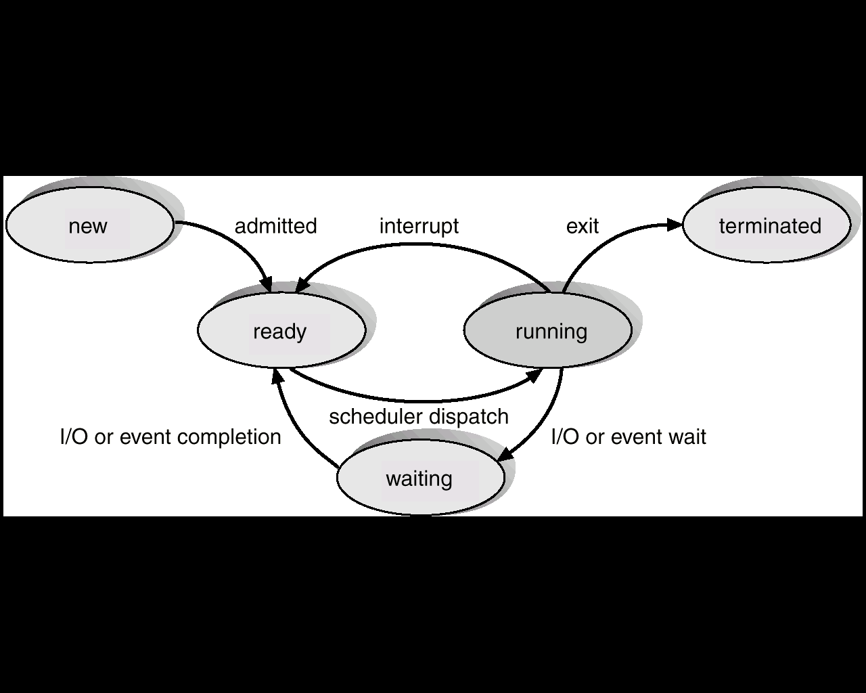
Process

Slide 32
Process
PROCESS CONTROL BLOCK:
CONTAINS INFORMATION ASSOCIATED WITH EACH PROCESS:
It's a data structure holding:
PC, CPU registers,
memory management information,
accounting ( time used, ID, ... )
I/O status ( such as file resources ),
scheduling data ( relative priority, etc. )
Process State (so running, suspended, etc. is simply a field in the PCB ).

Slide 33
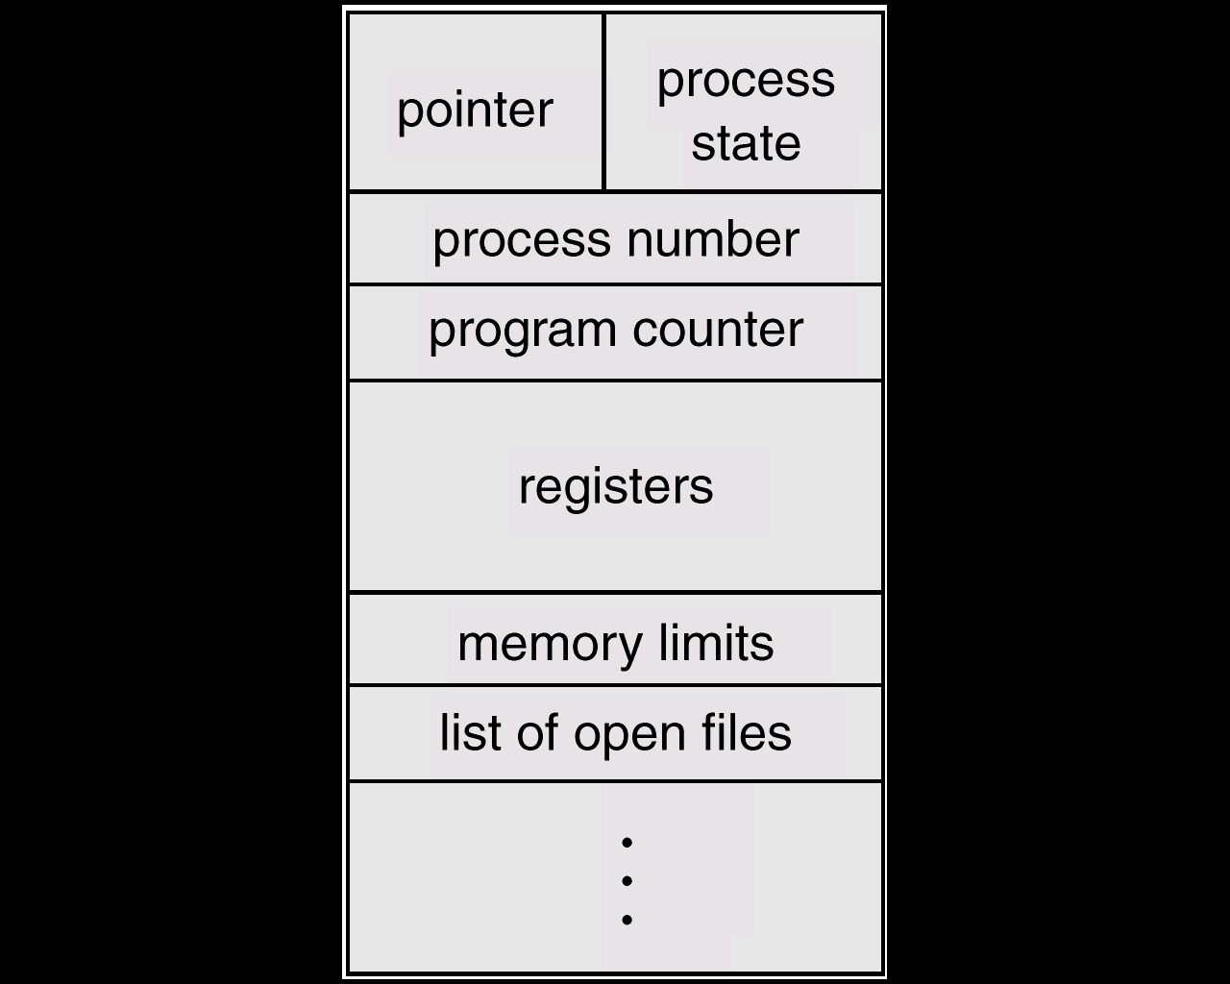
Process

Slide 34
Process
Process Scheduling
CPU scheduling is the basis of multiprogramming operating systems.
By switching the CPU among processes, the operating system can make the computer more productive.
If there are several runnable jobs, the operating system has to decide which job to run next, a process known as Process Scheduling.

Slide 35
Process
The computer operator simply submitted the jobs in the order that they were delivered to him or her, and each job ran to completion. We can call this algorithm First come first served, or FIFO (first in first out).
However, even this primitive system had problems. Suppose there are five jobs waiting to be run. Four of the five jobs will take about ten seconds each to run, and one will take ten minutes, but the ten-minute job was submitted first.
In a FIFO system, the fast jobs will all be held up for a long time by a large job that happened to be delivered first.

Slide 36
Process
This permitted the operator to run jobs using a shortest job first (SJF) algorithm.
As the name implies, instead of running jobs in the order that they are delivered, the operator would search through all available jobs and run that job which had the shortest run time.
This is probably the fastest job-scheduling algorithm.
If there are more processes, the rest will have to wait until the CPU is free and can be rescheduled.

Slide 37
Process
The act of Scheduling a process means changing the active PCB pointed by the CPU. Also called a context switch.
A context switch is essentially the same as a process switch - it means that the memory, as seen by one process is changed to the memory seen by another process.
SCHEDULING QUEUES:
(Process is driven by events that are triggered by needs and availability )
Ready queue = contains those processes that are ready to run.
I/O queue (waiting state ) = holds those processes waiting for I/O service.

Slide 38
Process
LONG TERM SCHEDULER
Run seldom ( when job comes into memory )
Controls degree of multiprogramming
Tries to balance arrival and departure rate through an appropriate job mix.
There are always more processes than CPU that can be executed by operating system. These processes are kept in large storage devices like disk later processing. The long-term scheduler select processes from this pool and loads them into memory. In memory these processes belong to a ready Queue. Queue is a type of data structure.

Slide 39
Process
SHORT TERM SCHEDULER
Code to take a process off the ready queue and run that process (also called dispatcher).
a) Always takes the first process on the queue (no intelligence required)
Places the process on the processor.
.

Slide 40
Process
It allocates processes that belong to ready queue to CPU for immediate processing.
Its main objective is to maximize CPU utilization. Compared to the other two schedulers, it is more frequent.
It must select a new process for execution quite often because a CPU execute a process only for millisecond before it goes for I/O operation.
.

Slide 41
Process
MEDIUM TERM SCHEDULER
Mixture of CPU and memory resource management.
Swap out/in jobs to improve mix and to get memory.
Controls change of priority.

Slide 42
Process
Most of the processes require some I/O operation.
In that case, it may become suspended for I/O operation after running a while.
It is beneficial to remove these process (suspended) from main memory to hard disk to make room for other processes.
At some later time these process can be reloaded into memory and continued from where it was left earlier. Saving the suspended processes is said to be swapped out or rolled out. The process is swapped in and swapped out by medium term scheduler.
.

Slide 43
Process
The medium term scheduler has nothing to do with suspended processes.
But the moment the suspending condition is fulfilled the medium term scheduler get activated to allocate the memory and swap in the process and make it ready for commenting CPU resources.
In order to work properly, the medium term scheduler must be provided with information about the memory requirement of swapped out processes, which is usually recorded at time of swapping and stored in related process control block.
.

Slide 44
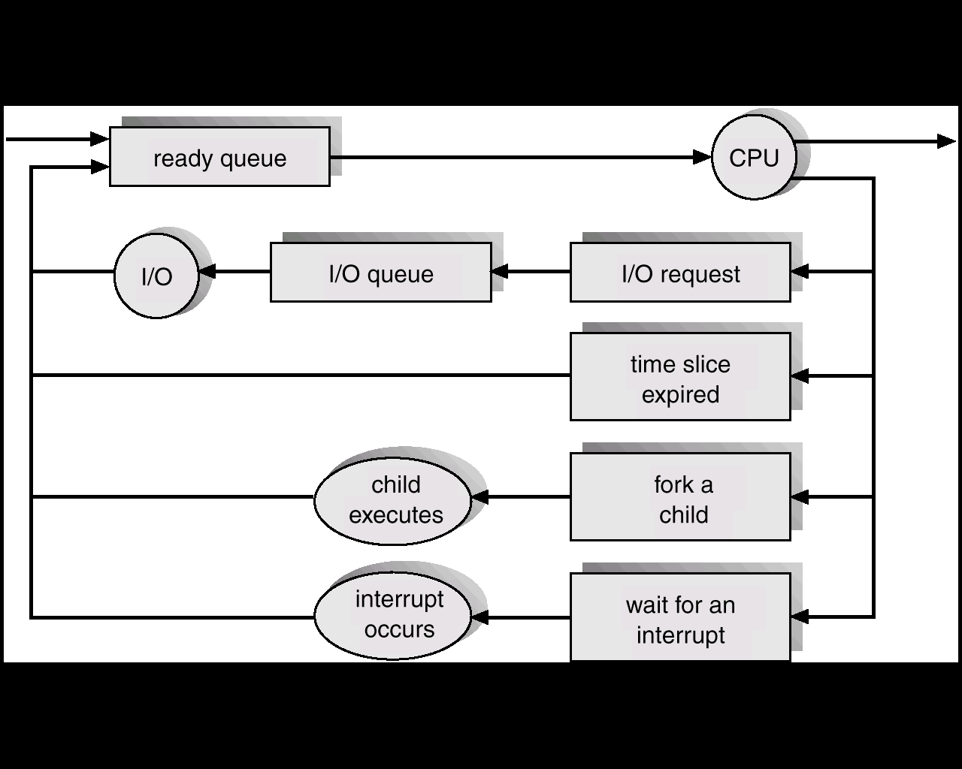
Process

Slide 45
Process Scheduling
First come first served scheduling
The process that requests the CPU first is allocated the CPU first. The average waiting time for FCFS policy is often quite long. Example:
Consider the following set of processes that arrive at time 0.
Process CPU Burst Time (ms)
P1 24
P2 3
P3 3
Suppose that processes arrive in the order: P1, P2, P3, we get the result
Waiting time for P1 = 0; P2 = 24; P3 = 27
Ave. waiting time: (0 + 24 + 27) /3 = 17 ms.

Slide 46
Process Scheduling
First come first served scheduling
If the processes arrive in the order: P2, P3, P1
Waiting time for P1 = 6; P2 = 0; P3 = 3
Ave. waiting time : (6 + 0 + 3)/3 = 3

Slide 47
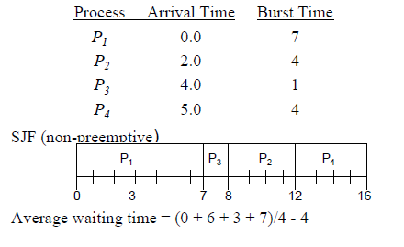
SJF Scheduling
Associate with each process the length of its next CPU burst. Use these lengths to schedule the process with the shortest time.

Slide 48
JOB
CPU bound: Processes that perform computations with little
I/O operations. Scientific and engineering computations usually
fall in this category.
I/O bound: Processes that perform I/O operations with little
computation. Commercial data processing applications usually
fall in this category.

Slide 49
Process creation
PARENT & CHILD PROCESSES
Parent can run concurrently with child, or wait for completion.
Child may share all (fork/join) or part of parent's variables.
Death of parent may force death of child.
Resource sharing between Parent and Child processes can be any one of the following type:
1. Parent and children share all resources.
2. Children share subset of parent’s resources.
3. Parent and child share no resources.
Execution may be one of the following two types:
1. Parent and children execute concurrently.
2. Parent waits until children terminate.

Slide 50
Process termination
When processes terminate following two things can happen:
Output data from child to parent (via wait).
Process’ resources are de-allocated by operating system.
Parent may terminate execution of children processes (abort) when :
Child has exceeded allocated resources.
Task assigned to child is no longer required.
Parent is exiting.
Operating system does not allow child to continue if its parent terminates.
Cascading termination.

Slide 51
Process
Independent - Execution is deterministic and reproducible. Execution can be stopped/ started without affecting other processes.
Cooperating - Execution depends on other processes or is time dependent. Here the same inputs won't always give the same outputs; the process depends on other external states.
Independent process cannot affect or be affected by the execution of another process.
Cooperating process can affect or be affected by the execution of another process
• Advantages of process cooperation
Information sharing
Modularity
Convenience

Slide 52
Interprocess Communication
Interprocess communication is a mechanism for processes to communicate and to synchronize their actions.
• IPC facility provides two operations:
send(message) – message size fixed or variable
receive(message)
• If processes P and Q wish to communicate, they need to:
establish a communication link between them
exchange messages via send/receive
• Implementation of communication link
physical (e.g., shared memory, hardware bus)

Slide 53
Direct Communication
Processes must name each other explicitly:
send (P, message) – send a message to process P
receive(Q, message) – receive a message from process Q
Properties of communication link
Links are established automatically.
A link is associated with exactly one pair of communicating processes.
Between each pair there exists exactly one link.
The link may be unidirectional, but is usually bidirectional.

Slide 54
Indirect Communication
Messages are directed and received from mailboxes (also referred to as ports).
Each mailbox has a unique id.
Processes can communicate only if they share a mailbox.
Properties of communication link
Link established only if processes share a common mailbox
A link may be associated with many processes.
Each pair of processes may share several communication links.
Link may be unidirectional or bi-directional.

Slide 55
Indirect Communication
Operations
create a new mailbox
send and receive messages through mailbox
destroy a mailbox
Primitives are defined as:
send(A, message) – send a message to mailbox A
receive(A, message) – receive a message from mailbox A

Slide 56
Process Synchronization
Concurrent access to shared data may result in data inconsistency.
Maintaining data consistency requires mechanisms to ensure the orderly execution of cooperating processes.

Slide 57
Bounded Buffer
Assume counter is initially 5. One interleaving of statements is: producer: register1 = counter (register1 = 5) producer: register1 = register1 + 1 (register1 = 6) consumer: register2 = counter (register2 = 5) consumer: register2 = register2 – 1 (register2 = 4) producer: counter = register1 (counter = 6) consumer: counter = register2 (counter = 4)
The value of count may be either 4 or 6, where the correct result should be 5.

Slide 58
Race Condition
Race condition: The situation where several processes access – and manipulate shared data concurrently. The final value of the shared data depends upon which process finishes last.
To prevent race conditions, concurrent processes must be synchronized.

Slide 59
The Critical-Section Problem
n processes all competing to use some shared data
Each process has a code segment, called critical section, in which the shared data is accessed.
Problem – ensure that when one process is executing in its critical section, no other process is allowed to execute in its critical section.

Slide 60
Solution to Critical-Section Problem
Following three conditions must be met by the algorithms for process synchronization:
Mutual Exclusion. If process P_{i} is executing in its critical section, then no other processes can be executing in their critical sections.
Progress. If no process is executing in its critical section and there exist some processes that wish to enter their critical section, then the selection of the processes that will enter the critical section next cannot be postponed indefinitely.
Bounded Waiting. A bound must exist on the number of times that other processes are allowed to enter their critical sections after a process has made a request to enter its critical section and before that request is granted.

Slide 61
Initial Attempts to Solve Problem
General structure of process P_{i} (other process P_{j})
do {
entry section
critical section
exit section
reminder section
} while (1);
Processes may share some common variables to synchronize their actions.

Slide 62
Algorithm 1
Shared variables:
int turn; initially turn = 0
turn - i ⇒ P_{i} can enter its critical section
Process P_{i}
do
{
while (turn != i) ;
critical section
turn = j;
reminder section
} while (1);
Satisfies mutual exclusion, but not progress

Slide 63
Semaphores
Synchronization tool or we can say an integer variable that is shared among processes.
can only be accessed via two indivisible (atomic) operations : wait () and signal ()
wait (S):
while S≤ 0 do no-op; S--; signal (S):
S++;
Initially Process P1 arrives when S=0, it modifies S= -1 and enters its critical section. This makes Process P2 waits. When P1 exits its critical section it signals and modifies S=0 and now P2 can enter its critical section by modifying S= -1.

Slide 64
Multithreading
Thread is basic unit of CPU utilization. Threads share a CPU in the same way as processes do .
All threads of a process also share the same set of operating system resources.
All threads of a process inherit parent’s address space and security parameters.
Each thread of a process has its own program counter, its own register states, and its own stack.
Referred as mini-process or lightweight process.

Slide 65
Multithreading

Slide 66
Multithreading
Threads differ from traditional multitasking operating system processes in that:
processes are typically independent, while threads exist as subsets of a process
processes carry considerable state information, whereas multiple threads within a process share state as well as memory and other resources
processes have separate address spaces, whereas threads share their address space
processes interact only through system-provided inter-process communication mechanisms.
Context switching between threads in the same process is typically faster than context switching between processes.

Slide 67
Threads are light weight. They don't have their own memory spaces and other resources unlike processes. All processes start with a single thread. So they behave like lightweight processes but are always tied to a parent "thick" process. So creating a new process involves allocating all these resources while cresting a thread does not. Killing a process also involves releasing all these resources while a thread does not. However, killing a thread's parent process releases all resources of the thread.

Slide 68
Memory Management
Memory is important resource of a computer system that must be properly managed for the overall system performance
Memory management module:
Keeps track of parts of memory in use and parts not in use
Allocates memory to processes as needed and deallocates when no longer needed

Slide 69
Logical vs. Physical Address Space
The concept of a logical address space that is bound to a separate physical address space is central to proper memory management.
Logical address – generated by the CPU; also referred to as virtual address.
Physical address – address seen by the memory unit.
Logical and physical addresses are the same in compile-time and load-time address-binding schemes; logical (virtual) and physical addresses differ in execution-time address-binding scheme.

Slide 70
Memory-Management Unit
Hardware device that maps virtual to physical address.
In MMU scheme, the value in the relocation register is added to every address generated by a user process at the time it is sent to memory.
The user program deals with logical addresses; it never sees the real physical addresses.

Slide 71
Swapping
A process can be swapped temporarily out of memory to a backing store, and then brought back into memory for continued execution.
Backing store – fast disk large enough to accommodate copies of all memory images for all users; must provide direct access to these memory images.
Roll out, roll in – swapping variant used for priority-based scheduling algorithms; lower-priority process is swapped out so higher-priority process can be loaded and executed.

Slide 72
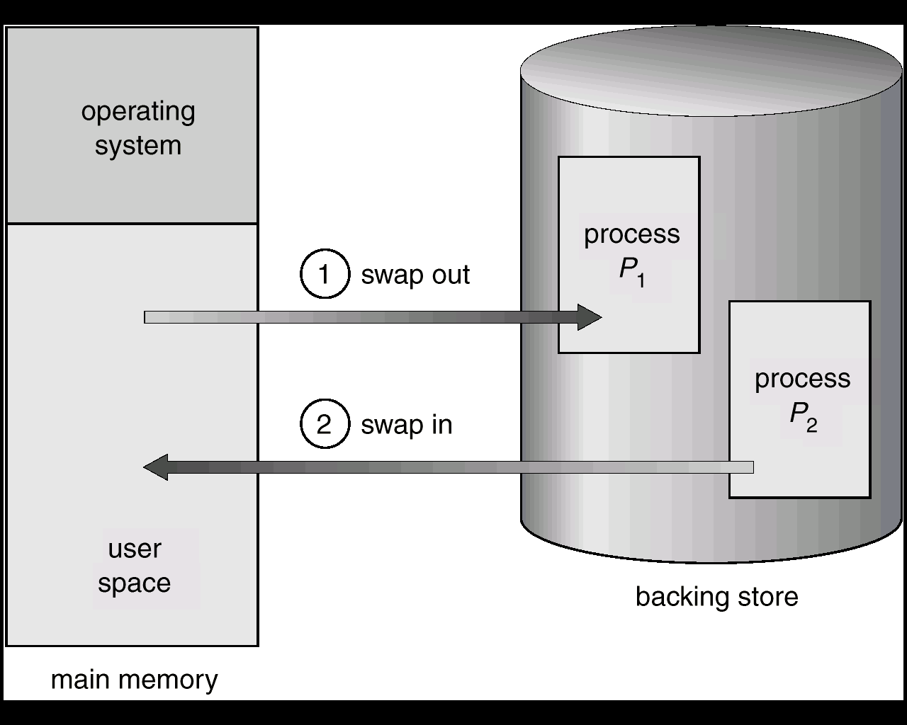
Schematic View of Swapping

Slide 73
Contiguous Allocation (Cont.)
Multiple-partition allocation
Hole – block of available memory; holes of various size are scattered throughout memory.
When a process arrives, it is allocated memory from a hole large enough to accommodate it.
Operating system maintains information about: a) allocated partitions b) free partitions (hole)
OS
OS
OS
OS
process 5
process 5
process 5
process 5
process 9
process 9
process 8
process 10
process 2
process 2
process 2
process 2

Slide 74
Dynamic Storage-Allocation Problem
First-fit: Allocate the first hole that is big enough.
Best-fit: Allocate the smallest hole that is big enough; must search entire list, unless ordered by size. Produces the smallest leftover hole.
Worst-fit: Allocate the largest hole; must also search entire list. Produces the largest leftover hole.

Slide 75
Fragmentation
External Fragmentation – total memory space exists to satisfy a request, but it is not contiguous.
Internal Fragmentation – allocated memory may be slightly larger than requested memory; this size difference is memory internal to a partition, but not being used.
Reduce external fragmentation by compaction
Shuffle memory contents to place all free memory together in one large block.

Slide 76
Paging
Logical address space of a process can be noncontiguous; process is allocated physical memory whenever the latter is available.
Divide physical memory into fixed-sized blocks called frames (size is power of 2, between 512 bytes and 8192 bytes).
Divide logical memory into blocks of same size called pages.
Keep track of all free frames.
To run a program of size n pages, need to find n free frames and load program.

Slide 77
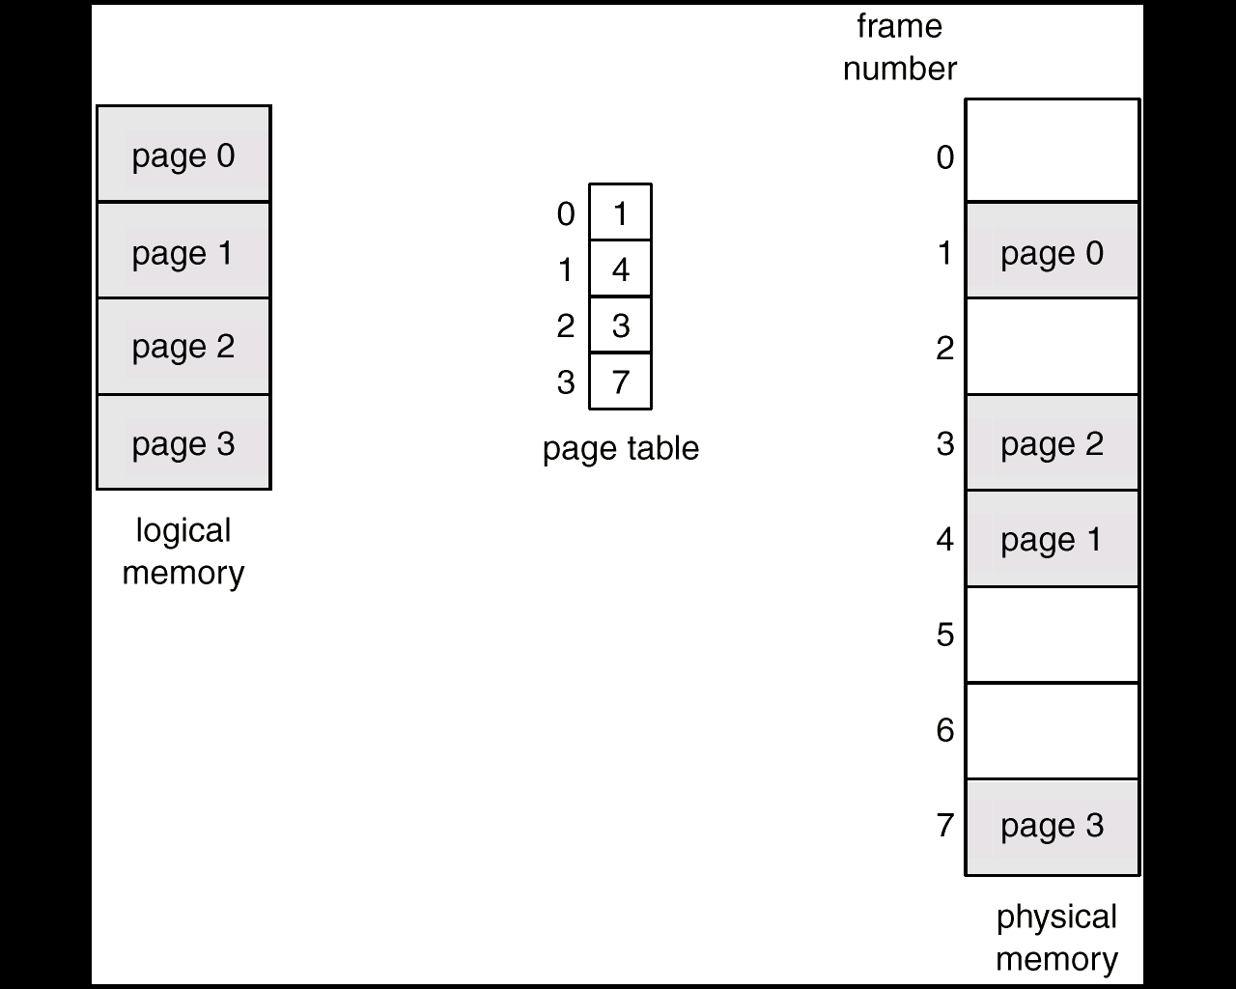
Paging Example

Slide 78
Implementation of Page Table
Page table is kept in main memory.
Page-table base register (PTBR) points to the page table.
Page-table length register (PRLR) indicates size of the page table.
In this scheme every data/instruction access requires two memory accesses. One for the page table and one for the data/instruction.
The two memory access problem can be solved by the use of a special fast-lookup hardware cache called associative memory or translation look-aside buffers (TLBs)

Slide 79
VIRTUAL MEMORY
Virtual memory – separation of user logical memory from physical memory.
Only part of the program needs to be in memory for execution.
Logical address space can therefore be much larger than physical address space.
Allows address spaces to be shared by several processes.
Allows for more efficient process creation.

Slide 80
Real, or physical, memory exists on RAM chips inside the computer. Virtual memory, as its name suggests, doesn’t physically exist on a memory chip. It is an optimization technique and is implemented by the operating system in order to give an application program the impression that it has more memory than actually exists. Virtual memory is implemented by various operating systems such as Windows, Mac OS X, and Linux.
So how does virtual memory work? Let’s say that an operating system needs 120 MB of memory in order to hold all the running programs, but there’s currently only 50 MB of available physical memory stored on the RAM chips. The operating system will then set up 120 MB of virtual memory, and will use a program called the virtual memory manager (VMM) to manage that 120 MB. The VMM will create a file on the hard disk that is 70 MB (120 – 50) in size to account for the extra memory that’s needed. The O.S. will now proceed to address memory as if there were actually 120 MB of real memory stored on the RAM, even though there’s really only 50 MB. So, to the O.S., it now appears as if the full 120 MB actually exists. It is the responsibility of the VMM to deal with the fact that there is only 50 MB of real memory.

Slide 81
Demand Paging
Bring a page into memory only when it is needed.
Less I/O needed
Less memory needed
Faster response
More users
Page is needed ⇒ reference to it
invalid reference ⇒ abort
not-in-memory ⇒ bring to memory

Slide 82
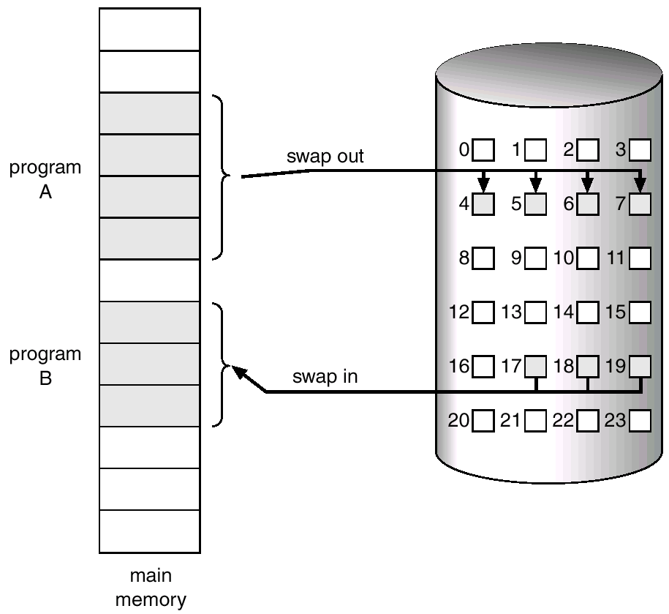
Transfer of a Paged Memory to Contiguous Disk Space

Slide 83
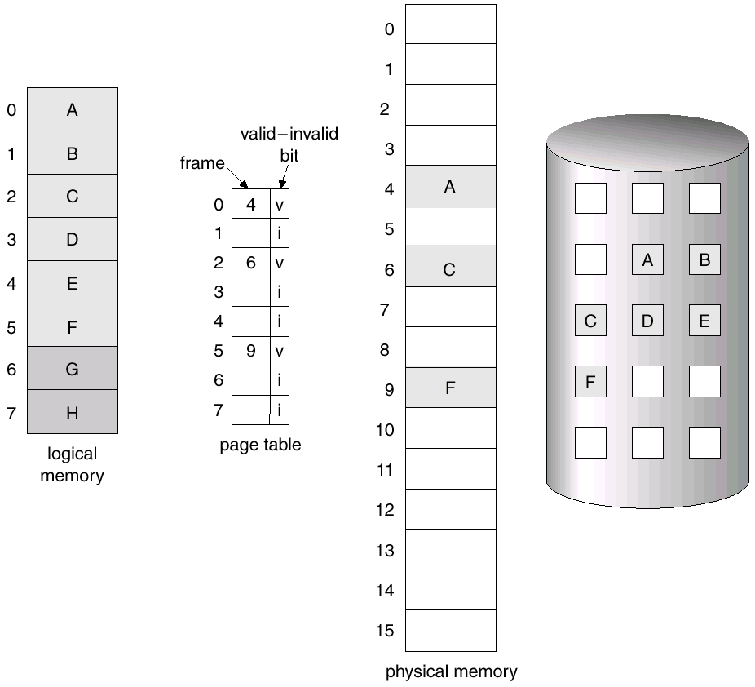
Page Table When Some Pages Are Not in Main Memory

Slide 84
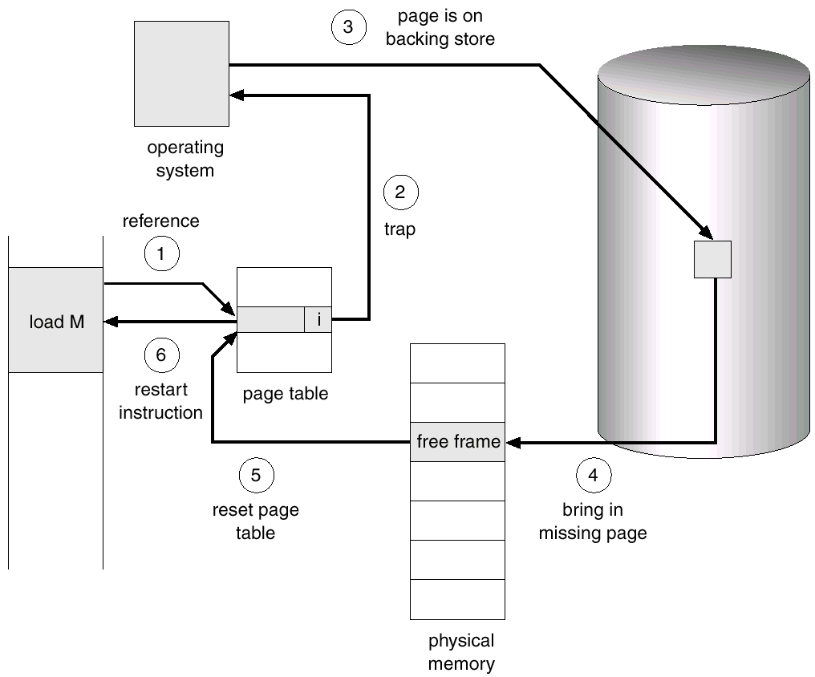
Steps in Handling a Page Fault

Slide 85
What happens if There is no Free Frame?
Page replacement – find some page in memory, but not really in use, swap it out.
algorithm
performance – want an algorithm which will result in minimum number of page faults.
Same page may be brought into memory several times.

Slide 86
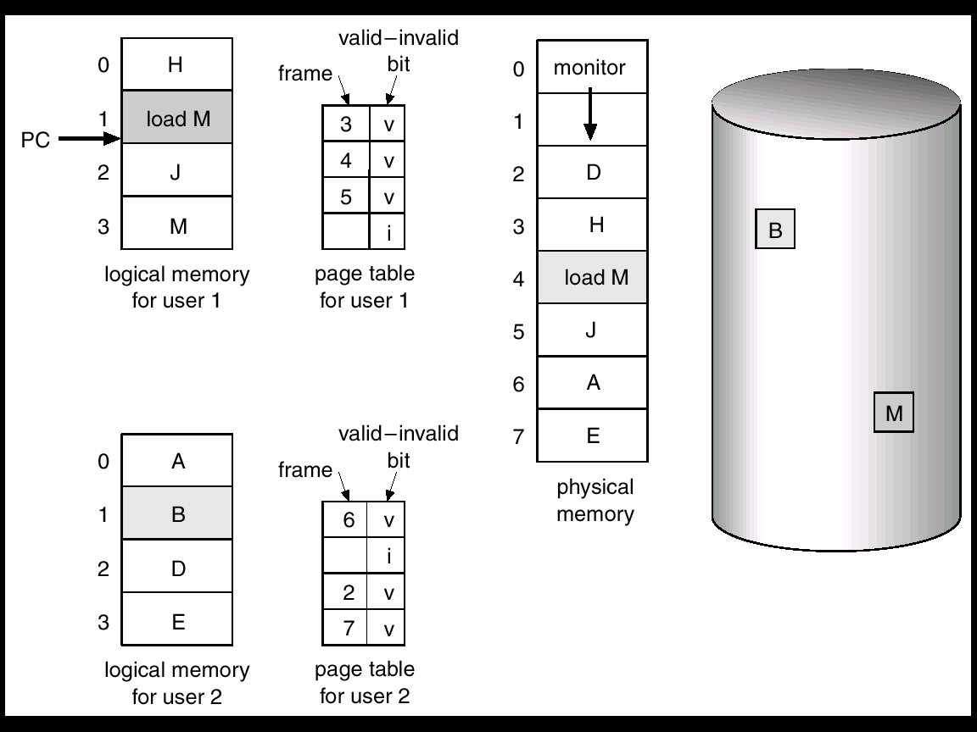
Need For Page Replacement

Slide 87
Basic Page Replacement
Find the location of the desired page on disk.
Find a free frame: - If there is a free frame, use it. - If there is no free frame, use a page replacement algorithm to select a victim frame.
Read the desired page into the (newly) free frame. Update the page and frame tables.
Restart the process.

Slide 88
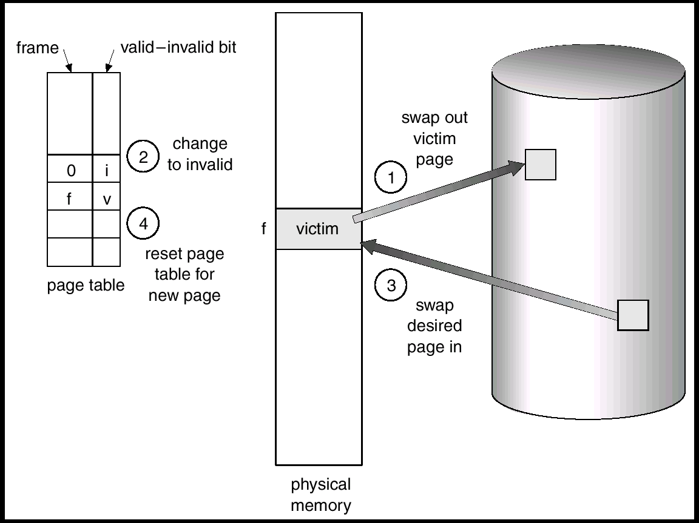
Page Replacement

Slide 89
Page Replacement Algorithms
There are various page replacement algorithms such as:
FIFO (First In First Out) – the page that was brought first is swapped out.
LRU (Least recently Used) – the page which is not used from the long time is swapped out.
LFU (Least Frequently Used) – the page that is used minimum number of times is swapped out.

Slide 90
File Management
A file is a collection of related information.
Every file has a name, its data and attributes.
File’s name uniquely identifies it in the system and is used by its users to access it.
File’s data is its contents.
File’s attributes contain information such as date & time of its creation, date & time of last access, date & time of last update, its current size, its protection features, etc.
File management module of an operating system takes care of file-related activities such as structuring, accessing, naming, sharing, and protection of files.

Slide 91
File Management
Two commonly supported file access methods are:
Sequential access: Information stored in a file can be accessed sequentially (in the order in which they are stored, starting at the beginning)
Random access: Information stored in a file can be accessed randomly irrespective of the order in which the bytes or records are stored

Slide 92
File Attributes
Name – only information kept in human-readable form
Type – needed for systems that support different types
Location – pointer to file location on device
Size – current file size
Protection – controls who can do reading, writing, executing
Time, date, and user identification – data for protection, security, and usage monitoring
Information about files are kept in the directory structure, which is maintained on the disk

Slide 93
File Operations
Create
Write
Read
file seek – reposition within file
Delete
Open(F_{i}) – search the directory structure on disk for entry F_{i}, and move the content of entry to memory.
Close (F_{i}) – move the content of entry F_{i} in memory to directory structure on disk.

Slide 94
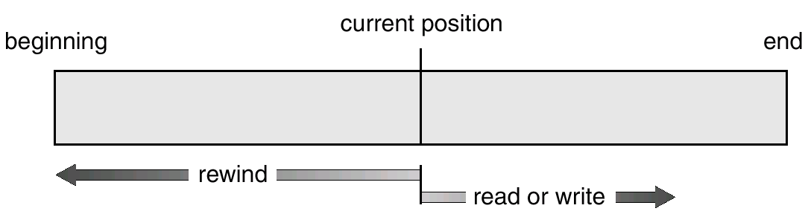
Sequential-access File

Slide 95
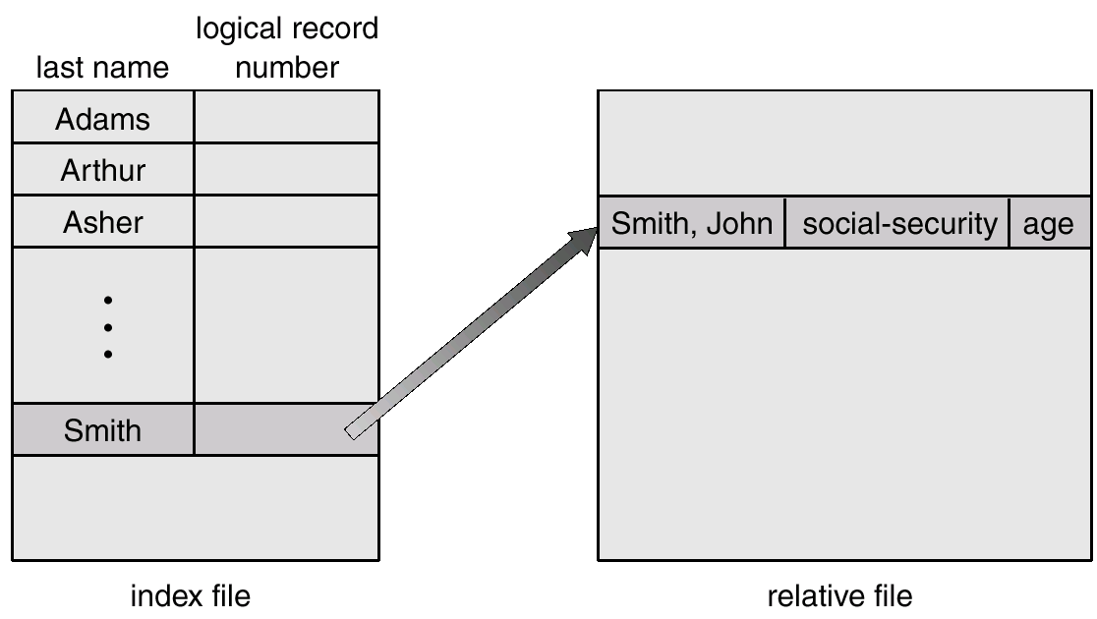
Example of Index and Relative Files

Slide 96
Directory Structure
A collection of nodes containing information about all files
Directory
Files
F 1
F 2
F 3
F 4
F n

Slide 97
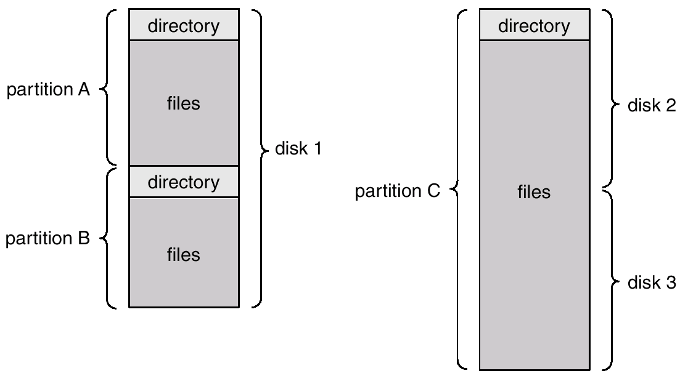
A Typical File-system Organization

Slide 98
Information in a Device Directory
Name
Type
Address
Current length
Maximum length
Date last accessed (for archival)
Date last updated (for dump)
Owner ID
Protection information (discuss later)

Slide 99
Operations Performed on Directory
Search for a file
Create a file
Delete a file
List a directory
Rename a file
Traverse the file system

Slide 100
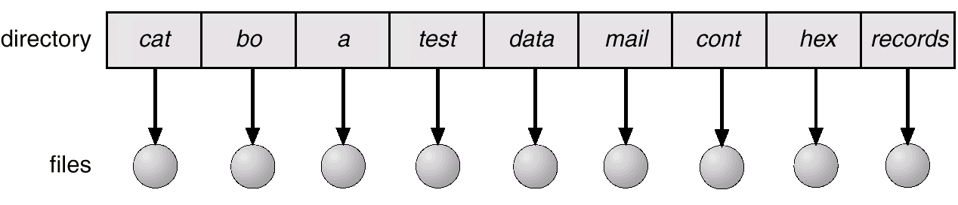
Single-Level Directory
A single directory for all users
Naming problem
Grouping problem

Slide 101
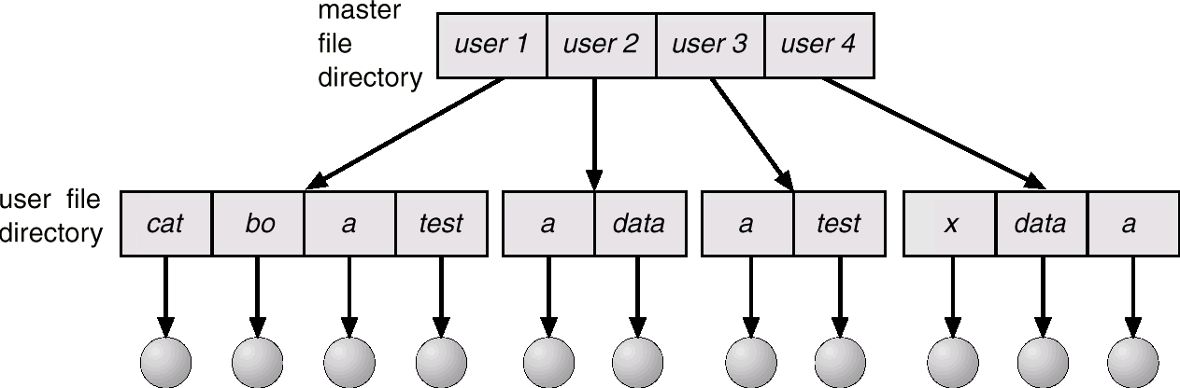
Two-Level Directory
Separate directory for each user
Path name
Can have the same file name for different user
Efficient searching

Slide 102
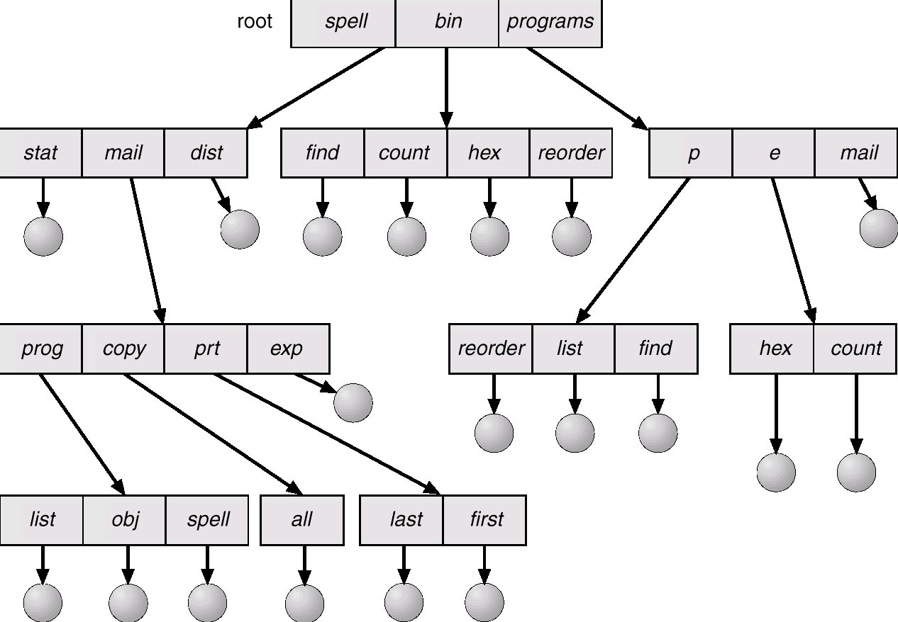
Tree-Structured Directories

Slide 103
Tree-Structured Directories
Efficient searching
Grouping Capability
Current directory (working directory)
cd /spell/mail/prog/list

Slide 104
Tree-Structured Directories
Absolute or relative path name
Creating a new file is done in current directory
Delete a file
rm <file-name>
Creating a new subdirectory is done in current directory
mkdir <dir-name>
Example: if in current directory /mail
mail
prog
copy
prt
exp
count

Slide 105
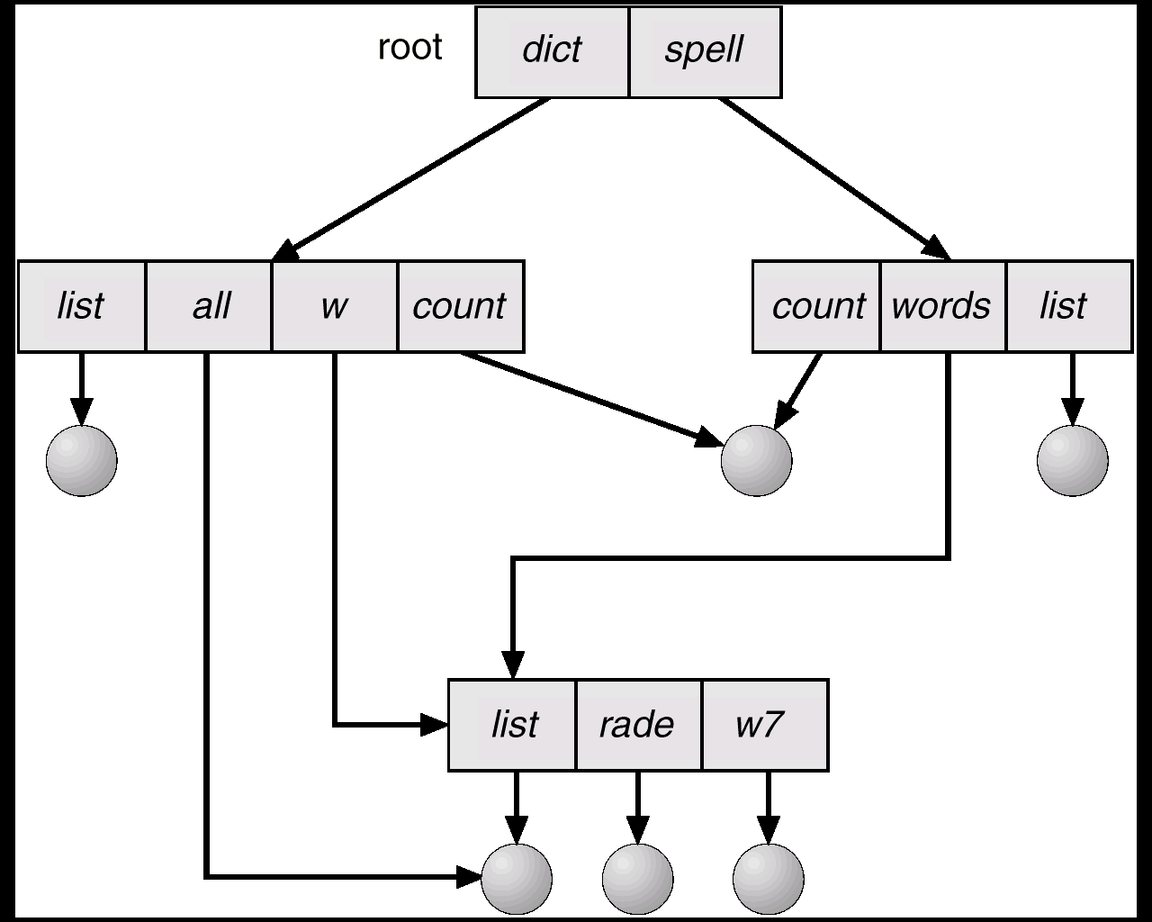
Acyclic-Graph Directories
Have shared subdirectories and files

Slide 106
Allocation Methods
An allocation method refers to how disk blocks are allocated for files:
Contiguous allocation
Linked allocation
Indexed allocation

Slide 107
Contiguous Allocation
Each file occupies a set of contiguous blocks on the disk.
Simple – only starting location (block #) and length (number of blocks) are required.
Allocation using first fit / best fit.
A Need for compaction.
Random access.
Wasteful of space (dynamic storage-allocation problem).
Files cannot grow.

Slide 108
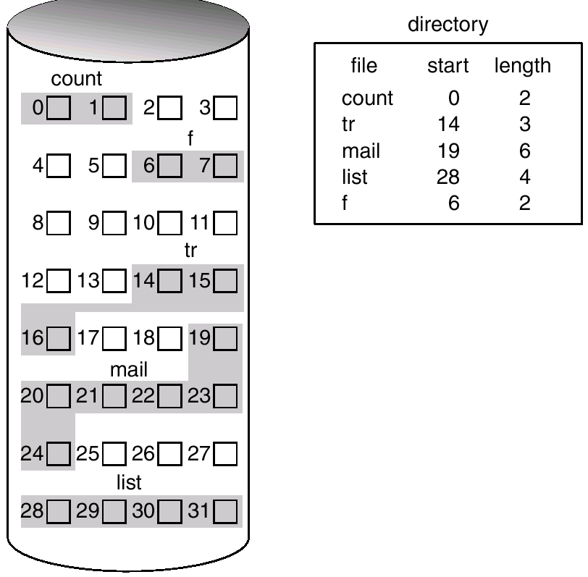
Contiguous Allocation of Disk Space

Slide 109
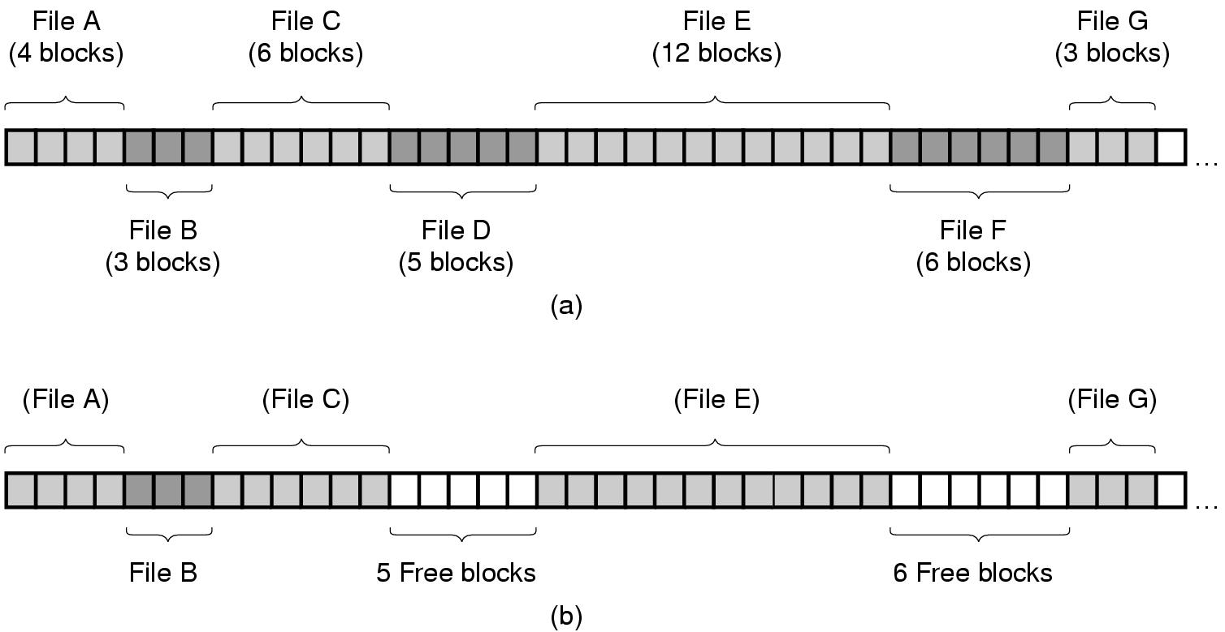
Contiguous Allocation Example
(a) Contiguous allocation of disk space for 7 files.
(b) The state of the disk after files D and F have been removed.

Slide 110
Linked Allocation
Each file is a linked list of disk blocks: blocks may be scattered anywhere on the disk.
Simple – need only starting address
Free-space management system – no waste of space
No random access
block =
pointer

Slide 111
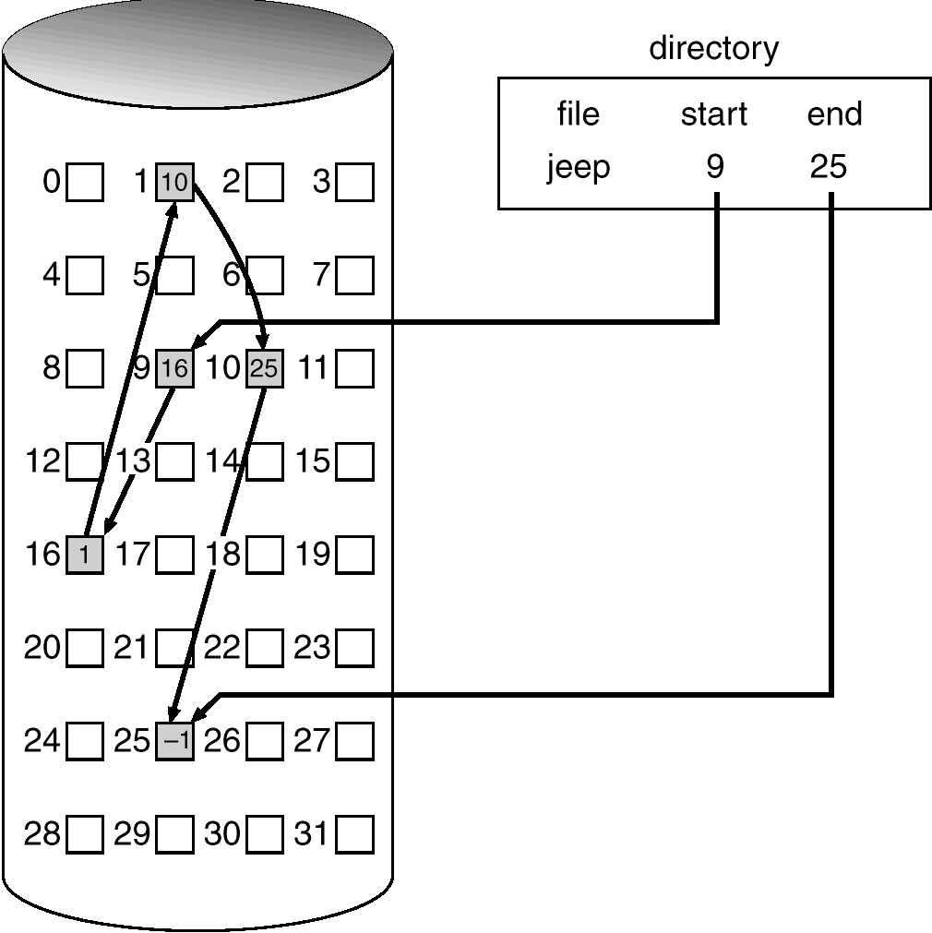
Linked Allocation

Slide 112
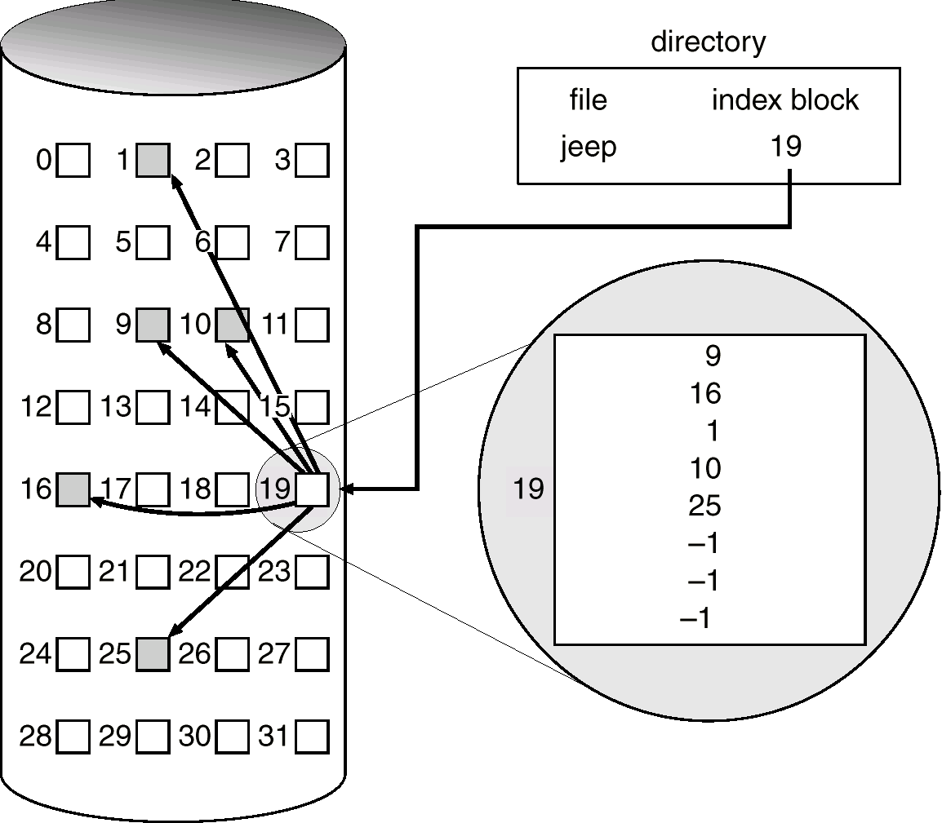
Example of Indexed Allocation

Slide 113
Indexed Allocation
Need index table.
Indexed allocation is bringing all the pointers together.
A data structure called an i-node (index-node), which lists the attributes and disk addresses of the files blocks
Random access
Dynamic access without external fragmentation, but have overhead of index block.
Each file has its own index block, which is an array of disk-block addresses. The entry in the index block points to the block of the file. The directory contains the address of the index block

Slide 114
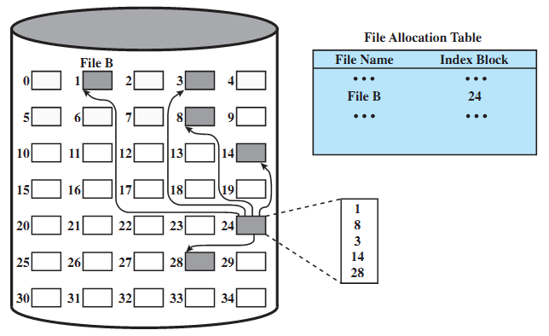
Indexed File Allocation Example

Slide 115
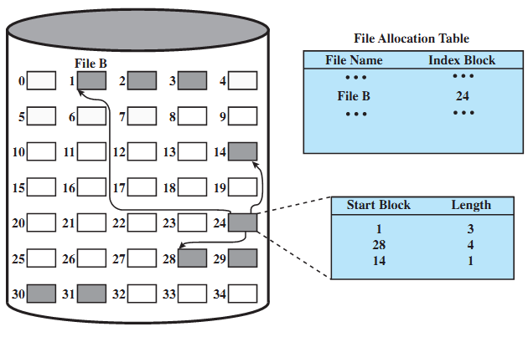
Indexed File Allocation (variable-size)

Slide 116
DBMS
What is a database ?
A database is any organized collection of data. Some examples of databases you may encounter in your daily life are:
a telephone book
T.V. Guide
airline reservation system
motor vehicle registration records
papers in your filing cabinet
files on your computer hard drive.

Slide 117
Data Base Management System
Data: Data is the basic raw,fact and figures
Ex: a name, a digit, a picture etc.
Data Base: Collection of related data
Ex. the names, telephone numbers and addresses of all the people you know
Data Base Management System:
A DBMS is a set of software programs that controls the organization, storage, management, and retrieval of data in a database.
Ex: MS-Access, Oracle, MS SQL, Sybase, IBM DB2

Slide 118
Use of DBMS
Corporate
Airlines
Hotels
Banks
Colleges /university
Railway reservation
Shopping Malls
Telecommunication Industry
Weather forecasting
Pattern Recognition
Data mining
Space Research
Software Industry

Slide 119
Data and Information
What is data?
Data can be defined in many ways. Information science defines data as unprocessed information.
What is information?
Information is data that have been organized and communicated in a coherent and meaningful manner.
Data is converted into information, and information is converted into knowledge.
Knowledge; information evaluated and organized so that it can be used purposefully.

Slide 120
Advantages of Using DBMS
Mass Data Storage
Centralized Access
Automatic Backup Possible
Data Recovery Possible
Security restrictions can be applied
Easily updation & fetching of data
Only authorized Access
No Data Redundancy
Data Consistency
etc…….

Slide 121
Disadvantages of Flat File Systems
No centralized control
Data Redundancy
Data Inconsistency
Data can not be shared
Standards can not be enforced
Security issues
Integrity can not be maintained
Data Dependence

Slide 122
Data Base Characteristics
Controls data redundancy.
Enforces user defined rules.
Ensures data sharing.
It has automatic and intelligent backup and recovery procedures.
It has central dictionary to store information.
Pertaining to data and its manipulation.
It has different interfaces via which user can manipulate the data.
Enforces data access authorization.
Represents complex relationship between data.

Slide 123
Need of Database ?
Data
Information
Knowledge
Action

Slide 124
Types of Database
Non-relational databases
Non-relational databases place information in field categories that we create so that information is available for sorting and disseminating the way we need it. The data in a non-relational database, however, is limited to that program and cannot be extracted and applied to a number of other software programs, or other database files within a school or administrative system. The data can only be "copied and pasted.“ Example: a spread sheet

Slide 125
Types of Database
Relational databases
In relational databases, fields can be used in a number of ways (and can be of variable length), provided that they are linked in tables. It is developed based on a database model that provides for logical connections among files (known as tables) by including identifying data from one table in another table

Slide 126
DBMS
Database model defines the manner in which the various files of a database are linked together.
Four commonly used database models are:
§ Hierarchical
§ Network
§ Relational
§ Object-oriented

Slide 127
Different Data Models
Flat file
Hierarchical Data Model
Network Data model
Relational Data model

Slide 128
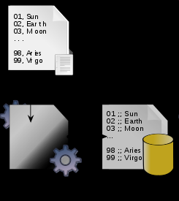
Flat Data model
This may not strictly qualify as a data model. The flat (or table) model consists of a single, two-dimensional array of data elements, where all members of a given column are assumed to be similar values, and all members of a row are assumed to be related to one another.

Slide 129
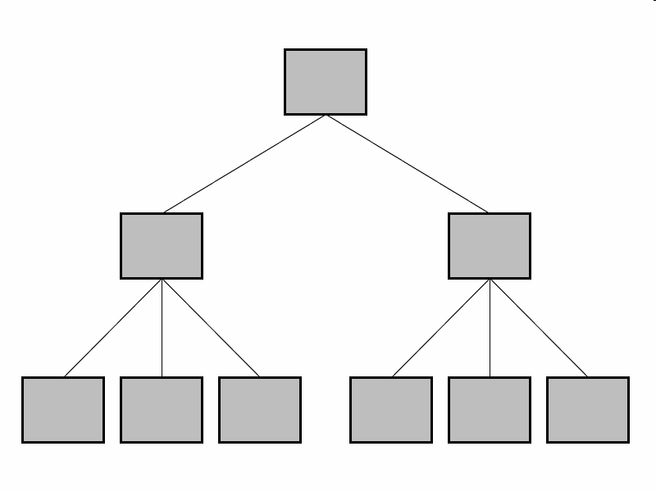
Hierarchical Data Model
In this model data is organized into a tree-like structure, implying a single upward link in each record to describe the nesting, and a sort field to keep the records in a particular order in each same-level list.

Slide 130
Example :Hierarchical DBMS
Data is represented by a tree structure
P1 | Nut | Red | 12 | London
P2 | Bolt | Green | 17 | Paris
S2 | Jones | 10 | Paris | 300
S3 | Blake | 30 | Paris | 200
S1 | Smith | 20 | London | 300
S2 | Jones | 10 | Paris | 400
S1 | Smith | 20 | London | 200
P3 | Screw | Blue | 17 | Rome
P4 | Screw | Red | 14 | London
S1 | Smith | 20 | London | 400

Slide 131
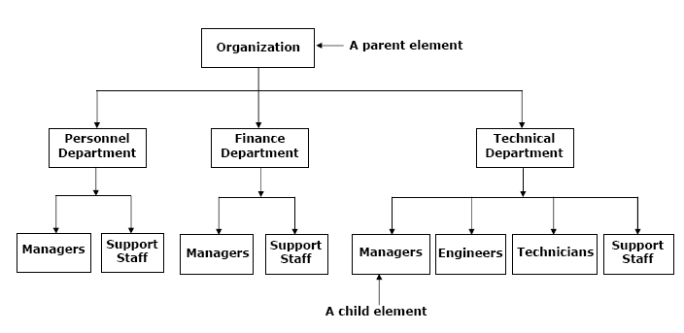
Hierarchical Model

Slide 132
Drawbacks: Hierarchical DBMS
Can not handle Many-Many relations.
It is easy to design but complex to implement.
It does not confirm to any specific standards.
Can not reflect all real life situations.
Difficult to perform insert, delete and update operations.

Slide 133
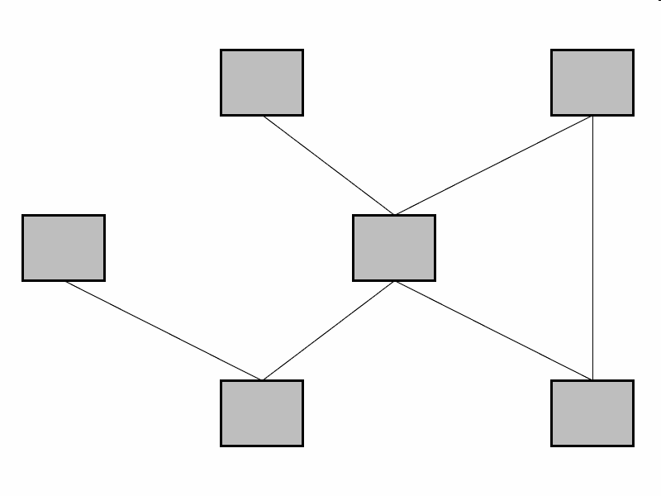
Network Data Model
This model organizes data using two fundamental constructs, called records and sets.
Records contain fields, and sets define one-to-many relationships between records: one owner, many members.

Slide 134
Network Data Model
Advantages
Easy and simple to design.
Capable of handling 1:N and M:N relationships.
Data access is easier.
Disadvantages
It is complex to implement.
Navigation is difficult using pointers.

Slide 135
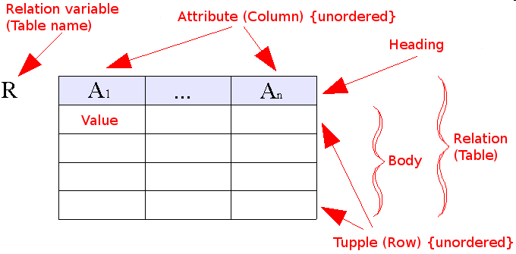
Relational Data Model
Relational model is based on relations of the tables.
It is bounded with 12 codd ’s rules.
Every information will be stored in the form of columns and rows.

Slide 136
Relational Data Model
Example of tabular data in the relational model
Attributes
Customer-id
customer-
name
customer-
street
customer-
city
account-
number
192-83-7465
019-28-3746
192-83-7465
321-12-3123
019-28-3746
Johnson
Smith
Johnson
Jones
Smith
Alma
North
Alma
Main
North
Palo Alto
Rye
Palo Alto
Harrison
Rye
A-101
A-215
A-201
A-217
A-201

Slide 137
Relational Database schema

Slide 138
Data Base Users
DBMS designers and implementers
Database administrator (DBA)
“superuser” of a database, similar to a system administrator.
Define schemas, views, authorization, indexes, tuning parameters, etc.
Application programmers
End users

Slide 139
Roles of Data Base Administrator
A database administrator (DBA) is a person responsible for the design, implementation, maintenance and repair of an organization's database. The key roles of a DBA are :
To Provide space to each user.
To create the external and logical Schema.
To Provide security from unauthorized access.
To grant permissions to the user
Installation, configuration and upgrading of Oracle server software and related products.
To take Back up and Recovery of data.
Performance monitoring of the machine and database.

Slide 140
Data Abstraction
Hiding system complexity and physical storage details from users and applications
Customized view
(External level)
View1
View 2
View n
Conceptual representation
Logical Level
Physical data description
(Internal level)
Physical level

Slide 141
Description of Levels
Users Level:
Any number of users may exists in this view.
Different users may have different external views for the same data.
It insulates the users from the details of internal & conceptual level.
Conceptual Level:
This level is designed by data base administrator.
Under this level a schema of data base is created by DBA.
It represents the entire database and there can be only one conceptual view per database.
It represents entities, their attributes and relationships between them.
It is independent on the hardware and software.
This is also known as Logical Level.
Internal Level:
It indicates how the data will be stored ad describes the data structures and access methods to be used by data base (ie. The physical implementation of data).
It is concerned with storage space allocation, indexes, data compression etc.

Slide 142
DBMS Components
DBMS allows users to organize, process and retrieve selected data from a database without knowing about the underlying database structure
Four major components of a DBMS that enable this are:
§ Data Definition Language (DDL): Used to define the
structure (schema) of a database
§ Data Manipulation Language (DML): Provides commands to enable the users to enter and manipulate the data.
§ Data Control Language (DCL) : Used to enforce constraints, grant and revoke privileges etc.

Slide 143
Name of the Data Models
Relational Model – DB2, Oracle, Informix, Sybase, MS-Access, Foxbase, Paradox, etc.
Hierarchical Model – IMS DBMS
Network Model – IDS & IDMS
Object-Oriented Model – ObjectStore & Versant
Object-Relational Model – Products from IBM, Oracle, ObjectStore, Versant.

Slide 144
Objective Type
The attributes of information are _________ , ________ and ________.
The database element that represents a correspondence between the various data elements is ______.
What are the characteristics of data in DBMS?
In the database system redundancy can be controlled. (T/F)
The goal of a concurrency management mechanism is to allow concurrency while maintaining the consistency of the shared data. (T/F)
MVS Stands for _______.
What is the primary purpose of he operating system?
Multitasking is also called parallel processing. (T/F)
Another term of multi-user is time sharing. (T/F)
The _______ Software of the operating system manages the jobs waiting to be processed.

Slide 145
Short Answer Type
What are the advantages of using a database?
What are the characteristics of quality information?
What is data processing?
What is file processing?
What is the difference between sequential and direct-access file processing?
What is database processing?
Write a short note on Multithreading.
How does an Operating system works?
What are the functions of an operating system?

Slide 146
Long Questions
What are the different types of Operating System ?
Explain DOS Commands ?
Write a short note on File Structure ?
Explain the Process management.
Explain the different types of data base systems ?
Explain Virtual Memory.
Describe the features of DOS.
Difference between CUI and GUI?
Explain Data Independence in database system.

